Slide 1
Introduction to VEEVA
LEVEL - PRACTITIONER

Slide 2
OBJECTIVE
After completing this chapter, you will learn to:
  Define VEEVA Systems
  Define VEEVA CRM Architecture
  Define VEEVA product Suites
  Define Supported platforms for VEEVA CRM
  Define VEEVA CRM language interface compatibility
  Define Product upgrade and New feature releases

Slide 3
Do You Know
VEEVA Inc. was founded in 2007
VEEVA has 1700+ employees (data as of 2015)
Cognizant is a VEEVA implementation/service partner

Slide 4
Introduction to VEEVA
VEEVA System

Slide 5

VEEVA Systems
  VEEVA is a CRM application built on the Salesforce.com platform designed specifically for the pharmaceutical and biotechnology industries
  The centralized and robust architecture of VEEVA help business users to manage, review and distribute sales and company regulatory data just over few click using simple GUIs in iPad has made VEEVA a leader in cloud-based software for the global life sciences industry

Slide 6
Introduction to VEEVA
VEEVA CRM Architecture

Slide 7
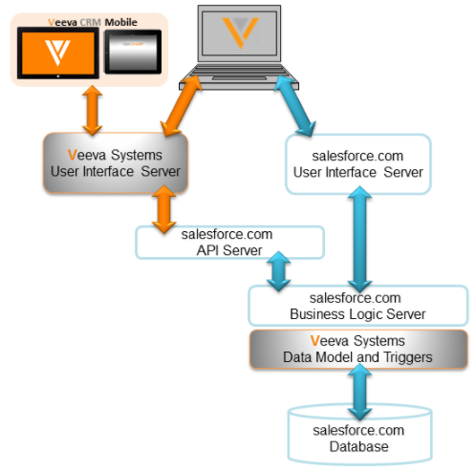
VEEVA CRM Architecture
The VEEVA CRM application is built on Salesforce SaaS platform
All the data storage, security, integration, customization is performed on Salesforce platform
The data-oriented logic behind VEEVA CRM is implemented in APEX code, and the mobile device GUI are designed using server-based JAVA

Slide 8
Introduction to VEEVA
VEEVA Product Suites

Slide 9
VEEVA Product Suite
Product | Key Feature | Additional features
VEEVA CRM | Customer Relationship Management | Advanced multichannel capabilities and real-time insights help engage health care professionals (HCPs) in the way and channel they prefer. Approved Email solution allows reps to send only preapproved communication to HCPs.
VEEVA Vault | Content and Data Management | Vault can store media content, approved email message, attachment, promotional items etc. Admin can configure workflow, and approval to ensure only valid and approved content is available to VEEVA CRM. All CRM related data is managed in VEEVA CRM. Vault has seamless integration with VEEVA CRM.
VEEVA Network | Customer Master and Master Data Management | Has over 10 million HCPs and health care organizations (HCOs). It is seamlessly integrated with VEEVA CRM.
VEEVA Open Data | Customer reference data management | Comprehensive customer reference data – HCPs, HCOs, affiliations, email, and compliance data delivered in VEEVA CRM.

Slide 10
Introduction to VEEVA
Supported platforms for VEEVA CRM

Slide 11



VEEVA CRM Supported platforms
VEEVA Offline applications with Go Online feature
iRep on iPad
Windows 10 mobile
Tablet PC
Note:
VEEVA Online can be directly used by login to Salesforce.com or any Salesforce custom domain using any compatible browser
Each mobile platform has some limitations in terms of functionalities available. Please see details here https://crmhelp.VEEVA.com/doc/Content/CRM_topics/Getting_Started/Features_by_Platform.htm

Slide 12
Introduction to VEEVA
VEEVA CRM language interface compatibility

Slide 13
VEEVA Language Compatibility
VEEVA provides following language packs for out-of-the-box translation of the applications:
In order to enable multiple languages users are required to log a case with VEEVA support
Bulgarian
Chinese (Simplified)
Chinese (Traditional)
Czech
Danish
Dutch
English
Finnish
French
German
Greek
Hungarian
Indonesian
Italian
Japanese
Korean
Portuguese (Brazil)
Polish
Romanian
Russian
Spanish
Spanish (Mexico)
Swedish
Thai
Turkish
Ukrainian
Vietnamese

Slide 14
Language Enablement
VEEVA admins must keep in mind the following to enable new language for VEEVA:
Do not modify the Company Language of your org. It should remain English (US) in order to ensure VEEVA upgrades can be completed
If user changes his language setting for iPad, he needs to do a refresh in order to apply the setting

Slide 15
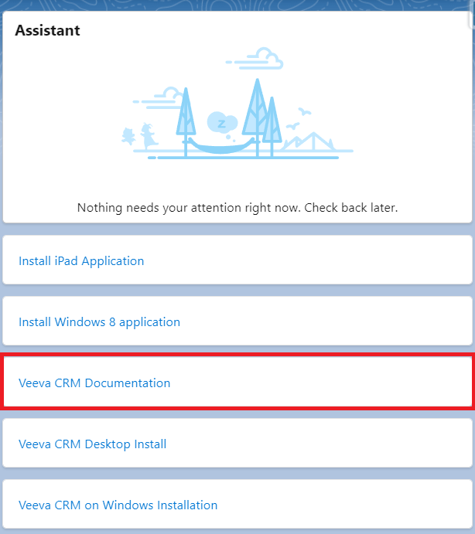
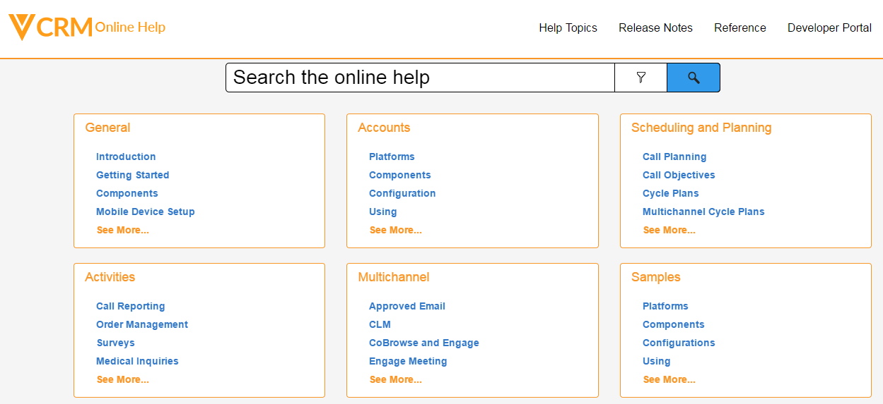
VEEVA Resources- Documentation
VEEVA CRM online help can be made available from a link in the homepage sidebar

Slide 16
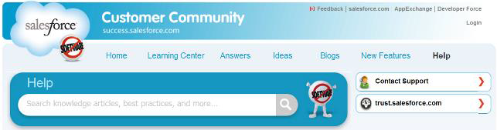
SFDC Resources- Documentation
Salesforce.com provides following Resources:
  Salesforce.com Help and Training
  Pre-recorded training sessions
  Documentation
  Developerforce.com
  Status.salesforce.com
  Salesforce.com Blog
  Additional training can be taken directly from Salesforce

Slide 17
VEEVA and SFDC Support
VEEVA Support Site
VEEVA support site URL:https://www.VEEVA.com/support
Customers can use the support site to log in support cases
NOTE: Partners should only request portal access if they are actively engaged with a customer and need to log cases on the customer's behalf
VEEVA CRM help online
Developers and Administrators can access VEEVA CRM help from https://crmhelp.VEEVA.com

Slide 18
Introduction to VEEVA
Product upgrade and New feature releases

Slide 19
VEEVA New Releases- Upgrades and Patches
VEEVA brings 3 platform releases each year (March, July, and November), which deploys New functionalities/features along with defect fixes
Delivery of New Releases are provided via upgrades to all customer orgs including Production and Full Sandbox environments. Customers are notified a minimum of 30 days in advance of Production org updates
All new features are defaulted “off” with exceptions stated in Release Notes. New releases are provided in Full Sandboxes 3 weeks prior to Production orgs availability
VEEVA does functional verification and regression testing for every new release. However, customers are responsible for enabling new features and then testing against those configurations prior to providing new features to end users
Patch Releases are delivered on an as-needed basis
  Customers are notified for each patch after subscribing for patch notifications in CRM Community. Patches only contain important defect fixes (i.e., where viable defect workaround is not available) and not new features. Patches are usually delivered during off business hours
  Note: This training material references to VEEVA version - 17R3

Slide 20
Check Your Understanding ... 1
1. Data oriented logic behind VEEVA CRM is implemented on which programming Language?
APEX
Java
C
C++
Answer: APEX

Slide 21
Check Your Understanding ... 2
2. VEEVA Online can be directly used by login to Salesforce.com or any Salesforce custom domain using any compatible browser.
State True or False.
True
False
Answer: True

Slide 22
Check Your Understanding ... 3
3. The _____ logic for VEEVA CRM is implemented in APEX triggers, while the _____ logic is implemented in server-based Java code using the Salesforce.com Composite Framework.
Data Oriented, User Interface
User Interface, Data Oriented
Answer: Data Oriented, User Interface

Slide 23
Check Your Understanding ... 4
4. Any formula field, or any formula within the formula field, cannot be modified.
State True or False
True
False
Answer: False

Slide 24
Check Your Understanding ... 5
5. Partners should only request portal access if they are actively engaged with a customer and need to log cases on the customer's behalf.
State True or False
True
False
Answer: True

Slide 25

Summary
In this module, you have learnt to :
  Describe VEEVA Systems.
  Describe VEEVA CRM Architecture
  Explain Core VEEVA products
  Describe Supported platforms for VEEVA CRM
  Explain VEEVA CRM language interface compatibility
  Explain Product upgrade and New feature releases

